Slide 1








Subject-verb
Agreement
Body

Slide 2


Proofread this advertisement to find the errors.

Slide 3



Imagine that you are a prospective client and that you saw this ad online. Would you call Terra Services to handle your next project? Probably not! Mistakes in subject-verb agreement can cost a company business. Paying careful attention to grammatical details ensures professionalism that clients will recognize and respect.
But what is Subject verb agreement? Lets Learn!

Slide 4



What is subject?
The subject is the doer of the action.
What is Verb?
Verbs are words that express an action, state or occurrence.

Slide 5


What is
subject-verb Agreement?
Subject
Verb
Subject-verb agreement refers to the relationship between the subject and predicate of the sentence, which must always agree in two ways: tense and number.

Slide 6
Rules of Subject verb agreement

Slide 7




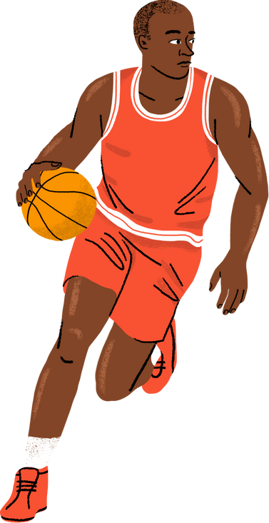



Basic Rule
The verb must agree with the subject in number and in person.
a.) If the subject is singular, the verb must be singular as well.
For example:
The boy plays basketball.
The subject of the sentence is "boy" and the verb is "plays." Both agree in number.
The subject "boy" is singular.
The verb "plays" is also in singular form.

Slide 8
Basic Rule
The verb must agree with the subject in number and in person.
b.) If the subject is plural, the verb must be plural as well.
For example:
The boys play basketball.
The subject of the sentence is "boys" and the verb is "play." Both agree in number.
The subject "boys" is plural.
The verb "play" is also in plural form.

Slide 9


Let's Try!
Mom (cook, cooks) breakfast at 7.
James (brings, bring) lunch to school.
Rosa and Matt (clean, cleans) the classroom every Tuesday.
The parents always (agrees, agree) with the teacher.
The children (plays, play) in the playground.
Read the sentences on the right and decide which verb matches the number of the subject correctly.

Slide 10


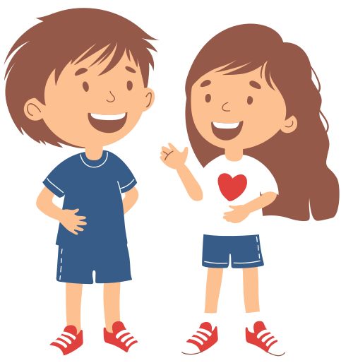
Basic Rule
Compound subjects that consist of more than 2 subject joined by “and”, take a plural verb.
For example:
Aman and Lona walk to college everyday.
The subjects of the sentence are “Aman” and “Lona” joined by and thus the verb is plural.

Slide 11


Rule Breaker :
Singular ( I and You)
do not add an s
I go to sleep.
You go to sleep.

Slide 12

Rule No. 01
Do not let a phrase between the subject and the verb trick you. The subject is what the verb agrees with, not a noun or pronoun in the phrase.
for example:
The student, as well as the committee members, is excited
The subject of the sentence is "student" and the verb is "is." Both agree in number.

Slide 13
Let's Try!
Read the sentences on the right and decide which verb matches the number of the subject correctly.
The students, as well as the parents, (plans, plan) for the party.
The student who competed in the competition (honors, honors) her mother.
The goal of the girls (is, are) to collect funds for the victims of the typhoon.

Slide 14
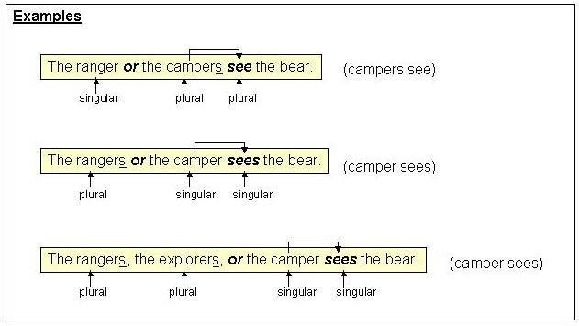
2. If two subjects are joined with correlative conjunctions such as “Either- or” , “ neither-nor” , “not only- but also”, then the verb follows the subject that is closer to it.

Slide 15
Let's Try!
Either the cats or the dog (eats, eat) food in the morning.
Neither the mother nor the children (know, knows) the way to the mall.
Not only the principal but also the teachers (submits, submit) the files every weekend.
Sean or Richard (has brought, have brought) home the cat.
Read the sentences on the right and decide which verb matches the number of the subject correctly.

Slide 16


3(a). The indefinite pronouns "each," "each one," "either," "neither," "everyone," "everybody," "anyone," "anyone," "nobody," "somebody," "someone," and "no one" are all singular and need a singular verb. (S.A.N.E)
Example: Each of the participants was willing to be recorded.

Slide 17
Rule No. 03(b)
The indefinite pronouns "both", "few", "fewer" , "many", "others" , and "several" are all plural and require a plural verb.
for example:
Both agree to the conditions.
The subject of the sentence is "both" and the verb is "agree." Both agree in number.
The subject in this sentence is "both."
Since the subject is "both", the verb must be plural.

Slide 18
Let's Try!
Read the sentences on the right and decide which verb matches the number of the subject correctly.
Everybody (likes, like) apple pie.
Few (wants, want) to be part of the organization.
Someone (refills, refill) the water dispenser every day.
Both (matches, match) that color.
Nobody (listens, listen) to the morning announcement.

Slide 19

4. Uncountable nouns(a) and collective nouns(b) take singular Verbs
Example A: Education is the key to success.
Example B: The committee agrees on the quality of the writing.

Slide 20

Rule Breaker :
Some countable nouns in English such as earnings, goods, odds, scissors, proceeds, trousers, and valuables which only have a plural form, take a plural verb.
Example: The earnings for this quarter
exceed expectations.

Slide 21
Let's Try!
Read the sentences on the right and decide which verb matches the number of the subject correctly.
The binoculars (is, are) dirty, so it's hard to use them.
The news (starts, start) at 8 in the evening.
The scissors (needs, need) shaping. Shorts (is, are) not allowed in the building.
Measles (spreads, spread) quicker than expected.

Slide 22

5. In sentences beginning with "there is" or "there are," “here is” or “here are” the subject follows the verb. Since "there/here" is not the subject, the verb agrees with what follows the verb.
Example: There is little administrative support.
Example: There are many factors affecting teacher retention.

Slide 23
Let's Try!
Read the sentences on the right and decide which verb matches the number of the subject correctly.
Here (is, are) the mail today.
There (is, are) chocolates in the fridge.
There (was, were) a haunted house near the road.
Here (is, are) the answer to your question from yesterday.
There (was, were) parents in the hallway a while ago.

Slide 24
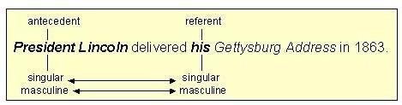
Note: Pronoun-Antecedent Agreement
Rule: A singular pronoun must replace a singular noun; a plural pronoun must replace a plural noun.
For Example:

Slide 25
Let's Practice!
Note the correct answers for the following.

Slide 26

1. Lack of sleep and poor nutrition often _____ in the body's breakdown.
a) results
b) result
2. Neither the textbook nor the lectures ______ the kind of detailed information that the instructor regularly puts on exams.
a) provides
b) provide
3. The temperature of the oceans that border Canada ______ the patterns of the country's fall and winter weather.
a) affects
b) affect
4. The build-up of gases in the air from burning large tracts of forest ______ to global warming.
a) contributes
b) contribute

Slide 27
5. After slash and burn, there ______ not enough nutrients in the soil to support vegetation.
a) is
b) are
6. A safe and healthy environment ______ in the top three concerns of Canadians these days.
a) ranks
b) rank
7. Every child and adult who purchases a ticket ______ eligible to receive a voucher from one of our sponsors.
a) is
b) are
8. Helena's choice for the perfect breakfast ______ bacon, eggs, toast, and coffee.
a) is
b) are

Slide 28
9. John Le Carre's "The Night Manager" is one of those books that ______ difficult to put down once you've started reading.
a) is
b) are
10. The team's success is due to the leadership of the coach and the dedication of the players, which ______ earned them a top place in the league.
a) has
b) have
11. Rising levels of carbon dioxide in the atmosphere ______ the growth of trees but ______ trees to die younger.
a) increases, causes
b) increases, cause
c) increase, cause
d) increase, causes

Slide 29

Answers
b
b
a
b
b
a
a
a
a
a
c

Slide 30







Thank You

